Slide 1
Software Engineering Practice
Buyang Cao
caobuyang@tongji.edu.cn
School of Software Engineering

Slide 2
Agenda
Introduction
  Instructors
  Course instruction and overview
Team building
Discussions
School of Software Engineering

Slide 3
Introduction
Instructor profile and previous career
  Name: Cao, Buyang (曹布阳)
  Astrology: scorpion
  Major: Operations Research
  Operation Research Lead, ESRI, Inc.
    Led projects in logistics arena
  Hobby: Soccer, Golfing, Swimming, Tennis, Travel
  Working hard, playing harder
Contact info:
  E-mail: caobuyang@tongji.edu.cn
  Cell phone: 15000215319
School of Software Engineering

Slide 4
Introduction
Instructor profile and previous career
  Name: Tang Jianfeng, Bill(唐剑锋)
  Astrology: Sagittarius
  Major: Software Engineering
  Led projects in mainframe banking applications
  Hobby: Reading
  Do the right thing in the right time
Contact info:
  E-mail: billtangjf@tongji.edu.cn
  Cell phone: 13916744257
School of Software Engineering

Slide 5
Introduction
Course instruction
  What is software engineering practice class?
    Not a programming language class
    Not a project management class
    Not a system analysis class
    Not a UML class
    Something of everything
School of Software Engineering
Notes:
The course will combine knowledge of programming language, project management, system analysis, and business requirement analysis

Slide 6
Introduction
Course instruction
  Mission statement:
  To explain how to apply various software engineering techniques (knowledge areas) to software projects so that the projects will be accomplished as specified, within budget, within the timeframe, and with good quality.
  Our ultimate goal: to have fun!
School of Software Engineering
Notes:
Team work, creative thinking

Slide 7
Course Introduction
  Schedule and contents: Course Schedule
  any issues?
School of Software Engineering
Notes:
The total time period will be for about a month. Any problem with the schedule? Some students may have to spend some time for practicing (internship).

Slide 8
Course Introduction
Topics to be covered
  Project management practices， particularly, risk management
  Business requirement elicitation and analyses
  System analyses and design (new techniques: e.g., machine learning/AI)
  Configuration management and bug tracking
School of Software Engineering

Slide 9
Review of past（partial） pre-course survey
Techniques and roles students want to focus on:
School of Software Engineering
Notes:
Team lead, project manager, system analyst, developer, QA. Not so many people want to do real developing jobs, someone didn’t like anything

Slide 10
Course Arrangement
Project teams
Team Presentations
Discussion
Team meetings
Evaluation (scores)
  Team work (contributions, etc.)
  Presentations
  Documentations
  Course attendance
School of Software Engineering
Notes:
We encourage team work, and need to utilize team members skills more effectively.

Slide 11
Teambuilding
Project team size: 5 - 6 people （can be flexible), maybe built upon your project management course teams
Name your team (creatively)
Team structure and roles (taking turn if possible)
  Team leader
  Project manager
  System analyst
  Developer
  QA
Team work and team goal
  “a team doesn’t come together well when each individual member focuses on their own target”.
School of Software Engineering
Notes:
We encourage team work, and need to utilize team members skills more effectively.

Slide 12
Teambuilding
What is a team:
A group of people who have been empowered to set goals, make decisions, and solve problems, and who have the commitment to make changes to implement their goals and decisions.
School of Software Engineering

Slide 13
Teambuilding
The Traits of a real team:
  Common goals
  Clear roles with flexibility
  Diversity
  Accountability/responsibility
  Leadership
  Cooperation
  Productivity
  Participation
  Trust
  Conflict management
School of Software Engineering

Slide 14
Teambuilding
Resolve conflict:
  Listen
  Accept the right of the other person to a satisfactory solution to the problem
  State your ideas and feelings frankly but calmly.
  Don’t start the conversation with your mind set up.
  Don’t try to win and cause other people to lose.
  Stick to the present.
  Raise the level of discussion.
  Use a rational, objective method to solve the problem.
  Take a break.
  Enjoy the rewards (win-win).
School of Software Engineering
Notes:
7: Identify the higher purpose that both of you are committed to. Look for solutions that meet each person’s needs.
8: early in discussion, work together to define the problem so that everyone can agree on what the problem is. List alternative solutions before deciding which is the best and mutually acceptable.

Slide 15
Teambuilding
Working together to because a mature team
Four stages:
  Defining (forming): what we are going to do together? What is our purpose? What are our goals and roles?
  Planning (storming): how will we carry out the work together? How will we accomplish goals and roles?
  Follow through (norming): the team takes action when the goals are set.
  Transforming (performing): the team members become problem solvers, decision makers, conflict managers, and goal setters. The team becomes mature. Wow.
School of Software Engineering

Slide 16
Teambuilding
Management controls the goal setting and planning process at early stages and the team become more self-directed as it matures:
Management control and authority
Team control and authority
School of Software Engineering

Slide 17
Teambuilding
Team lead: more responsibilities
Your leadership means:
  Helping others to define what’s important
  Helping others to accomplish what’s important
  Helping people to grow in the process
School of Software Engineering
Notes:
Team lead: the one takes more responsibilities
Some success rule for team leaders

Slide 18
Team Lead
Some success rules:
  Get them (team members) emotionally involved
    Get them convinced, because it is true that what they do makes difference.
  Encourage people
    Tell them they are going to do well before they are done.
  Let them make mistakes
    Tell me and I’ll remember for one hour; show me and I’ll remember for a day; but let me do it and I’ll remember for one year.
  Create a good atmosphere
    Without them you are nothing; with them you are a team
School of Software Engineering
Notes:
Team leader: the one takes more responsibilities
Some success rule for team leaders

Slide 19

Team Lead
Some success rules (cont.):
  Listen to ideas from others
    Talk to them. Get their feedback, their ideas, their creativity.
  Set an example/standards
    You’ve got to give your staff something to aspire to
  Learn from your mistakes
    Being a manager is an ongoing learning experience
  Manage your health
    If you want to live long and prosper, it pays to think now
  Enjoy yourself
    Nobody told you that you had to be serious and upright. All you were hired to do was your job.
  Celebrate: reward your team and yourself
    Buy your team members good food once a week!
School of Software Engineering
Notes:
Team leader: the one takes more responsibilities
Some success rule for team leaders

Slide 20
Software Architect Should Know
Communication is king
  Clarity: how you communicate, being clear and concise, not a 100-page architecture document
  Leadership: gaining respect from your team-members, creating healthy and effective working environment
Your biggest problem may not be technical (human’s error)
  Solving problem through proper conversation:
  Approaching problems as conversation, not as confrontation
  Approaching problems with right attitude
  Being calm and reasonable
  Setting mutually agree-upon goals
School of Software Engineering

Slide 21
Software Architect Should Know (cont.)
Application architecture determines application performance
  e.g.: No simple switching from one brand of software infrastructure to another to solve application performance issues
  Re-architecting and of internal logic or deployment strategy will be needed
Try before choosing
  Figuring out if the architecture decision to be made is suitable
  Trying multiple approaches might be the least expensive option.
School of Software Engineering

Slide 22
Software Architect Should Know (cont.)
Understand the business domain
  Understanding not only technology but also the business domain of a problem
  Being capable to translate business requirements into a technical architecture solution meeting them
  Knowing the industry trend of a specific domain to design an effective architecture
Time changes everything (nothing will be kept advanced all the time)
  Picking a worthy challenge: a good solution to the right challenge
  Simple rules: keep it simple, stupid.
  Being happy with old stuff: learn to embrace the old stuff, and resist the temptation to “fix” it
School of Software Engineering

Slide 23
Software Architect Should Know (cont.)
Empower developers
  Making sure developers have the needed tools
  Making sure developers have required skill sets (training, etc.)
  Letting developers make their own decisions
  Protecting developers from unnecessary parts of their job
Record your rationale
  Documentation can help:
  Communicate with developers (decisions, rules, etc.)
  Get team on the same-page
  Show messages to the project stakeholders
  Hand off the project to a new architect
School of Software Engineering

Slide 24
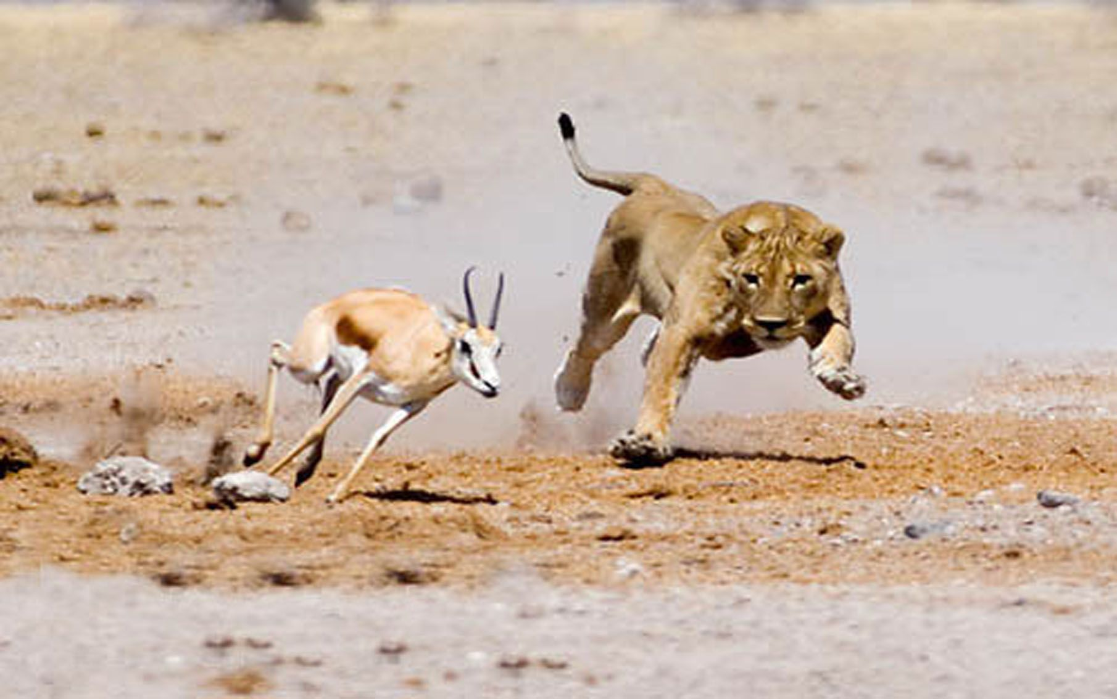
Help Make Your Team Competitive
Every morning in Africa, a gazelle wakes up
It knows it must run faster than the fastest lion or it will be killed
Every morning a lion wakes up
It knows it must outrun the slowest gazelle or it will starve to death
It doesn’t matter whether you are a lion or a gazelle
When sun comes up, you better start running
School of Software Engineering
Notes:
Working harder and smarter

Slide 25
Exercise: Team Briefing
Build your team
  Your team name
  Your team lead
  Your team members
  Your team mission statement (goals)
  How to achieve these goals
School of Software Engineering

